Slide 1
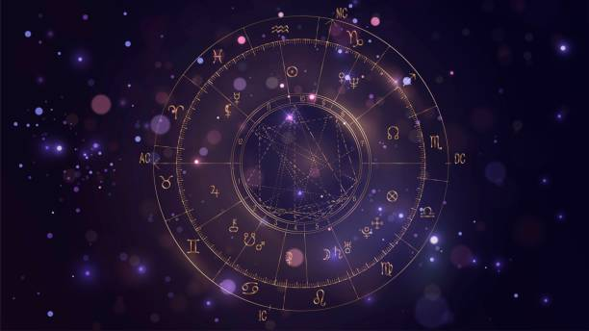
Zodiac Sign Prediction
Join Us on a Journey Through Stars and Algorithms!
Group 5
Ahmed Abdulrahim
Bimsara Geethachapa Siman Meru Pathiranage
Simranjeet Kaur
Efemena Theophilus Edoja
Simran

Slide 2
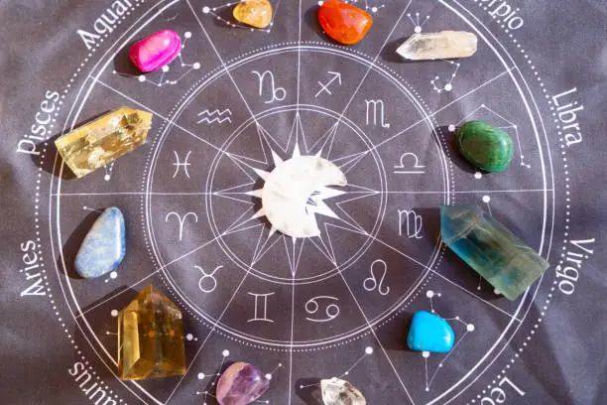
Unveiling the essence
Astrology, a timeless art, has always intrigued humanity with its celestial insights.Our project takes this ancient wisdom into the digital age by harnessing Python programming and machine learning techniques to predict Zodiac signs.
The core objective of this project is to utilize machine learning and natural language processing methods to forecast the astrological signs of bloggers by analyzing their written content.
Notes:
Zodiac signs are often used to describe an individual's personality traits, behaviors, strengths, and weaknesses based on their birth date. People often identify with the characteristics associated with their zodiac sign.
The primary business goal of this project is to leverage machine learning and natural language processing techniques to predict the astrological signs of bloggers based on their written content.
While astrology might seem unconventional for business applications, the potential for gaining deeper insights into customers' personalities and behaviors cannot be underestimated. The Blogs provide a rich source of data that, when combined with predictive analytics, can empower businesses with a fresh perspective on customer engagement, retention, and growth strategies. By understanding customers on a more personal level, businesses can foster lasting relationships and thrive in an increasingly competitive market.

Slide 3
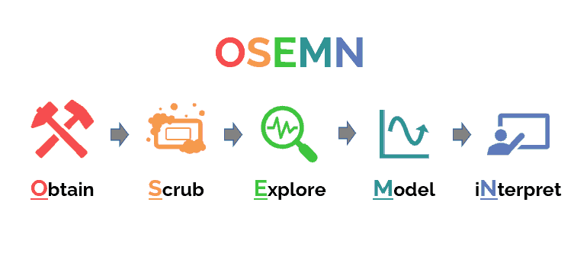
Methodology
OSEMN offers a structured approach that encompasses five essential stages, ensuring a comprehensive and effective exploration of the data:
Notes:
We started with the Obtain phase, where we identified the problem and defined the project goal. Next, in the Data Understanding phase(Scrub), we gathered and the dataset containing blog texts and corresponding zodiac signs. Then, we moved to the Data Preparation or Explore phase, where we cleaned, transformed, and prepared the data for modeling. The Modeling phase involved building and testing several machine learning models to predict zodiac signs. We then evaluated the performance of the different models in the Evaluation phase and selected the best one.

Slide 4

Obtain: Business Understanding
Businesses can unlock a range of valuable insights:
Personalized Marketing
Content Recommendation
Product Development
Customer Relationship Management
Market Segmentation
Competitive Edge
Content Creation
Notes:
1. Personalized Marketing: Predicting astrological signs can help businesses segment their audience more precisely. Tailoring marketing campaigns according to zodiac signs' characteristics can lead to higher engagement and conversion rates. For instance, offering promotions or content that resonates with specific astrological traits can capture users' attention.
2. Content Recommendation: By understanding bloggers' astrological signs, businesses can offer personalized content recommendations. Astrological insights can be used to suggest articles, products, or services that align with users' preferences, enhancing the user experience and driving user engagement.
3. Product Development: Knowledge of astrological signs can provide valuable insights into customers' preferences, interests, and behaviors. Businesses can use this information to fine-tune existing products or create new ones that cater to specific astrological traits, increasing the chances of success in the market.
4. Customer Relationship Management: Understanding users' astrological traits can help businesses establish stronger connections. Personalized interactions that consider astrological attributes can foster better customer relationships and loyalty.
5. Market Segmentation: Astrological sign prediction adds a new dimension to market segmentation. Businesses can group customers based on astrological traits to identify niche markets, discover trends, and design strategies that cater to these unique segments.
6. Competitive Edge: By leveraging advanced analytics and astrological predictions, businesses can differentiate themselves from competitors. Offering personalized experiences based on astrological insights can attract customers seeking unique and customized interactions.
7. Content Creation: Astrological insights can guide content creation strategies. Businesses can tailor blog posts, social media content, and advertisements to resonate with specific astrological sign traits, enhancing engagement and sharing.

Slide 5
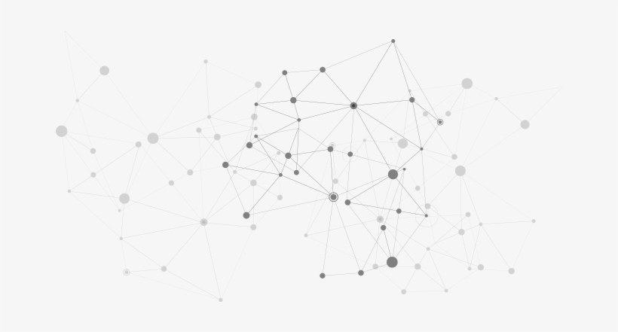
Data Understanding
Proper dataset comprehension ensures accurate insights and valid conclusions.
Understanding data helps allocate resources efficiently, saving time and effort.
Insights from dataset understanding lead to informed and confident decision-making.
Recognizing biases in data allows for fairer and more ethical outcomes.
Dataset understanding aligns models with real-world scenarios, improving their relevance.
Identify potential risks associated with using the data, such as legal, ethical, or privacy concerns.
Informed hypothesis based on understanding of dataset as a result enabling more effective analysis

Slide 6
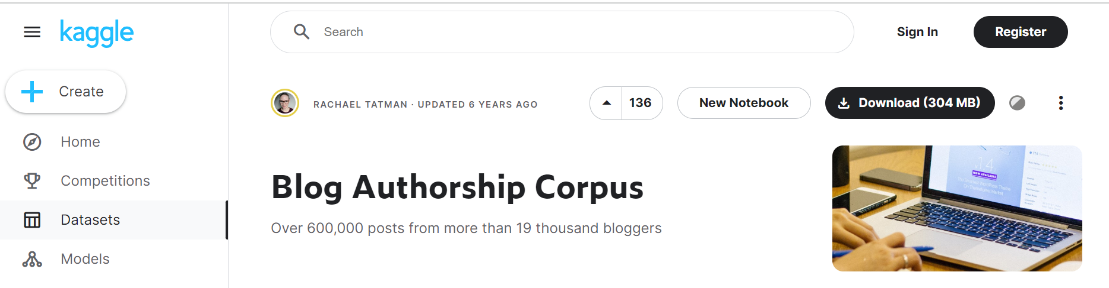
Our dataset originates from Kaggle, a respected platform known for sharing datasets within the data science and machine learning domain.
Kaggle serves as a reliable hub where data enthusiasts share datasets, making valuable resources accessible to the community.
For our zodiac sign prediction project, we've specifically chosen a dataset from Kaggle that aligns seamlessly with our objectives.
https://www.kaggle.com/datasets/rtatman/blog-authorship-corpus

Slide 7
Why this dataset?
Data Source Authenticity: Ensuring the authenticity of the data source is essential to maintain the integrity of the project.
Data Size and Diversity: Provides a substantial amount of textual content for analysis.
Zodiac Sign Labels: Fundamental requirement of our Project
Textual Content: Helps identify writing patterns specific to each zodiac sign.
Age and Gender Distribution: Offers potential insights into how writing styles may vary across demographics.
Data Preprocessing Potential: Provides room for various preprocessing techniques, such as cleaning, tokenization, and lemmatization.
Ethical Considerations: The dataset adheres to ethical guidelines, ensuring the privacy and anonymity of the bloggers.
Notes:
Ensuring data source authenticity from reputable academic website maintains project integrity.
The dataset's extensive content from 19,000 bloggers enriches analysis and model robustness through diverse writing styles.
Accurate zodiac sign labels for each blogger’s post fulfill the fundamental requirement of our Zodiac Sign Prediction project, aligning the data with our predictive goal.
The dataset's bloggers' posts offer valuable textual content, forming the core of our predictive model to identify zodiac sign-related writing patterns.
The dataset categorizes bloggers by age and gender, allowing us to explore potential writing style variations across demographics, adding context to our analysis.
The original text data can be cleaned, broken into parts, and simplified, giving us the chance to improve it for better analysis and model creation.

Slide 8
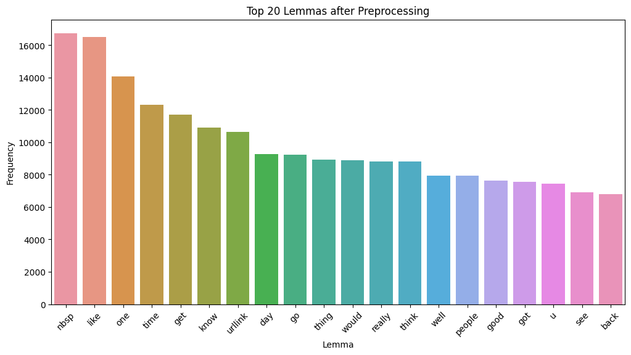
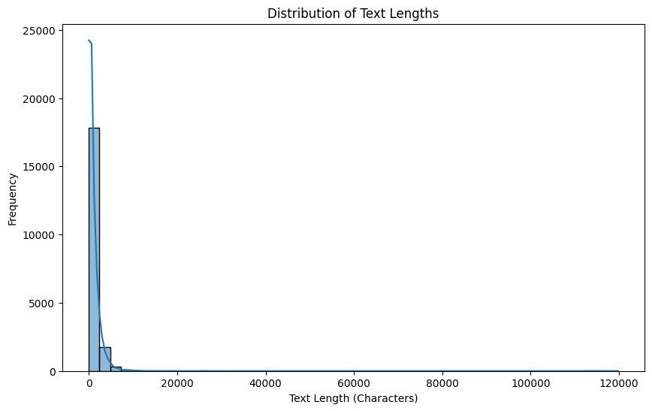
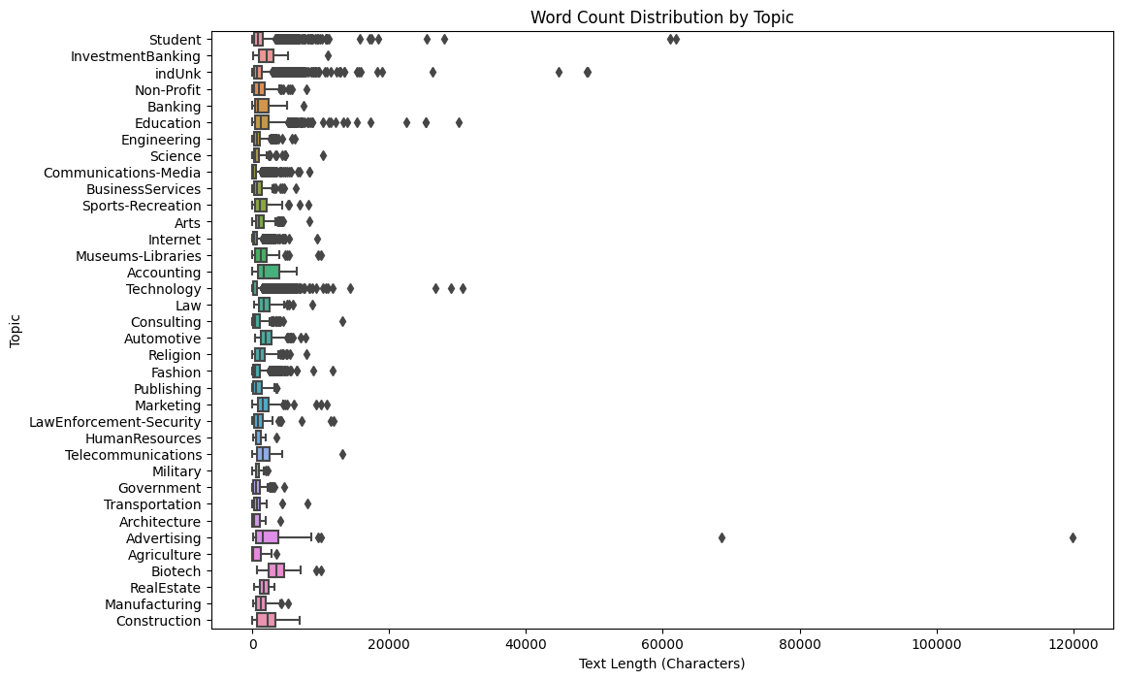
Explore: Data Preparation
Data Cleaning
Text Preprocessing
Label Encoding
Feature Extraction
Notes:
Key Steps:
Data Cleaning: Handle missing values, duplicates, and inconsistencies.
Text Preprocessing: Lowercase, remove special characters/numbers, tokenize, remove stop words, and lemmatize text.
Label Encoding: Convert astrological signs into numerical labels using LabelEncoder.
Feature Extraction: Utilize TF-IDF to transform processed text into numerical format.
As the dataset consists of bloggers' posts, we applied text preprocessing techniques to prepare the textual content for analysis. This included lowercasing, removing special characters and numbers, tokenization, and removing common English stop words. Additionally, lemmatization was applied to reduce words to their base or root form, aiding in standardizing the text.

Slide 9
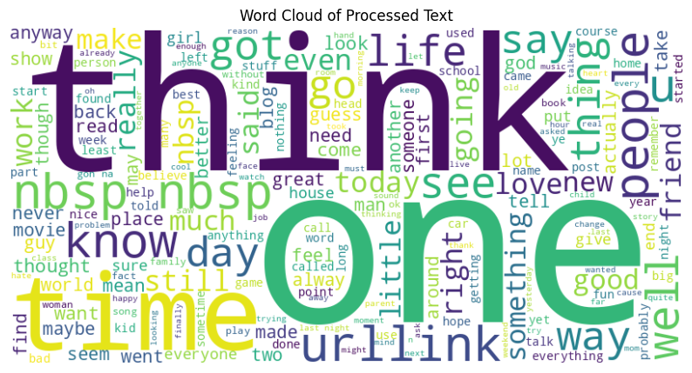
Data Preparation - Explore Phase
Analysis:
Explore zodiac sign distribution and attribute summary statistics.
Visualize data distributions and frequency of zodiac signs.
Feature Selection:
Focus on significant words/phrases associated with specific signs.
Visualization:
Create count plots for zodiac sign occurrences in the dataset.
Notes:
Analysis:
Explore zodiac sign distribution and attribute summary statistics.
Visualize data distributions and frequency of zodiac signs.
Feature Selection:
Focus on significant words/phrases associated with specific signs.
Visualization:
Create count plots for zodiac sign occurrences in the dataset.

Slide 10
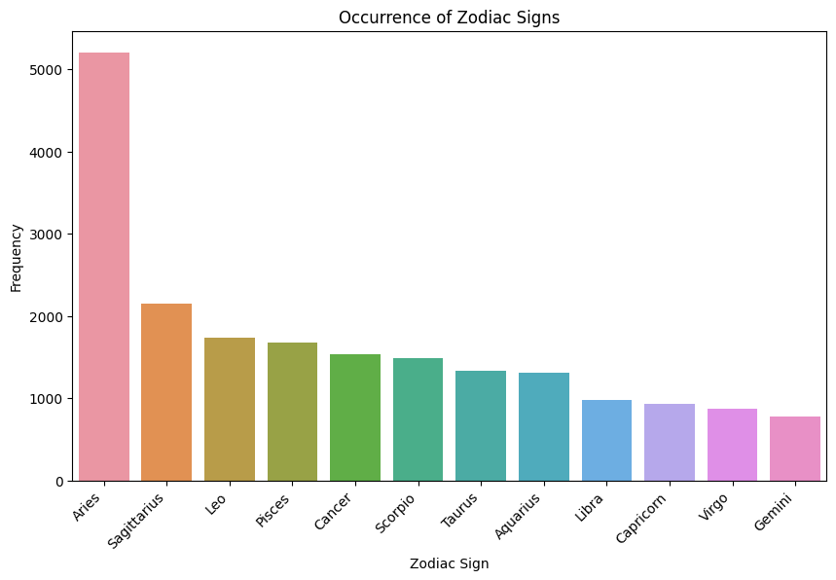
Impact of Data Preparation and Exploration
Significance:
Ensures accurate, clean, and well-structured data for analysis.
Identifies meaningful features to enhance model performance.
Provides insights into zodiac sign distribution and patterns.
Contribution:
Improves accuracy and effectiveness of Zodiac Sign Prediction models.
Informs subsequent stages of model development and evaluation.
Enables data-driven decision making for reliable predictions.
Notes:
Significance:
Ensures accurate, clean, and well-structured data for analysis.
Identifies meaningful features to enhance model performance.
Provides insights into zodiac sign distribution and patterns.
Contribution:
Improves accuracy and effectiveness of Zodiac Sign Prediction models.
Informs subsequent stages of model development and evaluation.
Enables data-driven decision making for reliable predictions.

Slide 11

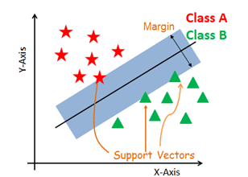
Model
Random Forest Classifier:
Ensemble Learning
Feature Importance
Robustness
Why We Chose It:
Ability to handle complex relationships
Mitigate overfitting
Provide feature importance analysis
Linear Support Vector Classifier:
Effective Separation
Margin Maximization
Notes:
Random Forest Classifier:
Advantages:
Ensemble Learning: The Random Forest Classifier is an ensemble learning method that combines multiple decision trees to improve accuracy and reduce overfitting. Given the complexity of human writing styles, an ensemble approach helps capture intricate relationships between features and zodiac signs.
Feature Importance: Random Forest provides insights into feature importance, enabling us to understand which writing characteristics contribute most to predicting zodiac signs. This is crucial for interpreting the results and gaining meaningful insights.
Robustness: Random Forest is less prone to overfitting compared to individual decision trees, making it suitable for handling noise and variations in the dataset. This robustness is particularly valuable when dealing with real-world data, which may have inherent uncertainties.
Why We Chose It:
We opted for the Random Forest Classifier due to its ability to handle complex relationships, mitigate overfitting, and provide feature importance analysis. With the diverse nature of blog posts and zodiac sign prediction, this model offers a strong foundation for accurate classification.
Linear Support Vector Classifier:
Advantages:
Effective Separation: The Linear Support Vector Classifier is highly effective at separating data points into distinct classes, making it well-suited for tasks with clear boundaries, such as classifying zodiac signs based on writing styles.
Margin Maximization: SVM aims to maximize the margin between classes, leading to better generalization and improved performance on unseen data. This is crucial for creating a reliable predictive model.
Why We Chose It:
The Linear Support Vector Classifier was chosen for its ability to effectively classify data, maximize margins, and potentially capture hidden patterns through kernel transformations. As zodiac signs are distinct categories, the SVM's separation capabilities align well with the classification task.

Slide 12
Hyperparameter Tuning
Efficient Resource Usage
Interpretability
Importance of Optimal Hyperparameters
Enhanced Performance
Avoid Overfitting
Search | Parameters | Best Parameters
Randomized Search CV | C: 0.01, 0.1, 1, 10 Regularization parameter Loss: 'hinge','squared_hinge' Loss function Max_iter: randint(100, 500) Maximum number of iterations | C: 1 loss: hinge Max_iter: 350 Best Accuracy: 0.5416
Grid Search | C: 0.8, 0.9, 1, 1.1, 1.2 loss: 'hinge' (Use the best 'loss' value) max_iter: 300, 350, 400 | C: 1.2 max_iter: 300 Best Accuracy: 0.5433
Notes:
Importance of Optimal Hyperparameters:
Enhanced Performance: Right hyperparameters boost accuracy and generalization.
Avoid Overfitting: Incorrect settings lead to overfitting or underfitting.
Efficient Resource Usage: Prevent wasted computation on suboptimal setups.
Interpretability: Tuned hyperparameters align model behavior with data.

Slide 13
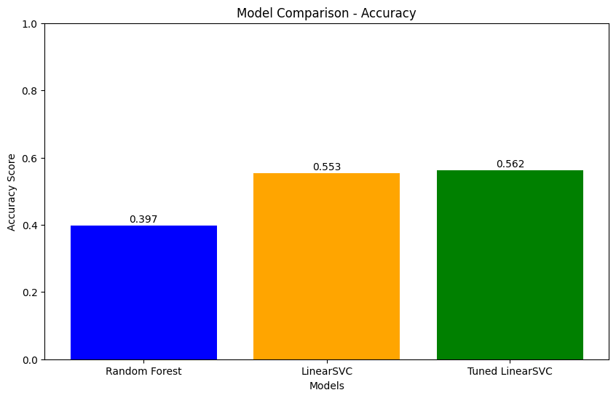
Interpretation
To measure performance of each model we used
Accuracy score
Model | Random Forest | Linear SVC | Tuned Linear SVC
Accuracy score | 0.397 | 0.553 | 0.562
Notes:
The accuracy score for a Random Forest classification model is the proportion of correctly predicted instances (samples) out of the total number of instances in the dataset.
Accuracy=TP + TN/ Total .. So, the accuracy represents the proportion of correctly classified instances (both positive and negative) out of the total instances.
​

Slide 14
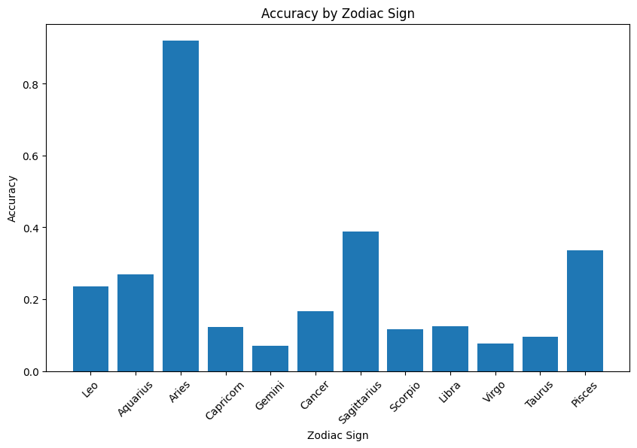
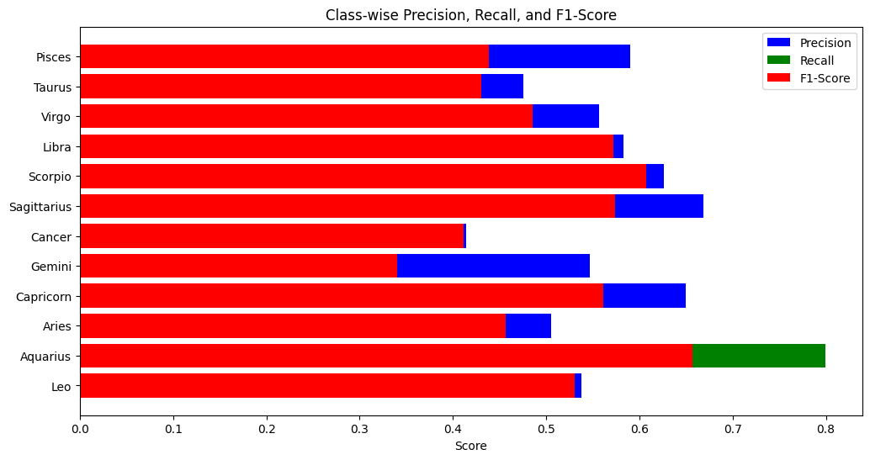
Random Forest Classifier
Top Accuracy: Aries
lowest accuracy: Gemini
Analyzing accuracy by zodiac sign provides valuable insights into the performance of our prediction model and suggests potential areas for improvement
Linear SVC
Highest Precision: Gemini
Highest Recall: Aquarius
Highest F1-Score: Aquarius
Analyzing class-wise precision, recall, and F1-score provides a comprehensive understanding of our model's performance across different zodiac signs
Notes:
Precision: Proportion of true positives (correctly predicted positive instances) among all instances predicted as positive.
Recall: Proportion of true positives among all actual positive instances.
F1-score: A harmonic mean of precision and recall, providing a balance between the two metrics.
These metrics help you assess the Random Forest model's performance in classifying instances into different classes.
the equations for accuracy, precision, recall, and F1-score are universal across various classification algorithms, including Random Forest and LinearSVM. These metrics provide a comprehensive evaluation of how well the models are performing in terms of classifying instances into different classes, taking into account various aspects of prediction correctness and balance between different types of errors.

Slide 15
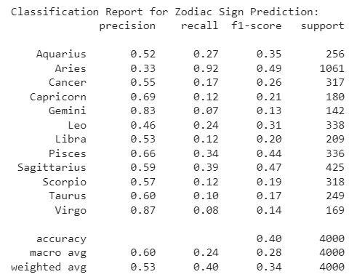
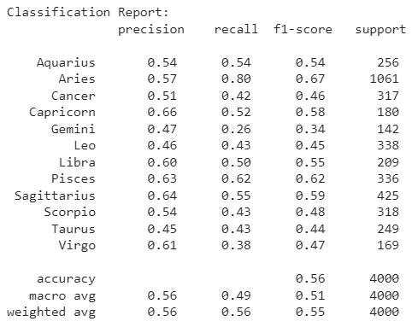
To measure performance of each model we used
Classification report
Notes:
The classification report provides insights into how well the model is performing on each class, allowing you to identify if the model is better at predicting certain classes than others. It's an essential tool for model evaluation, particularly in multi-class classification problems.

Slide 16
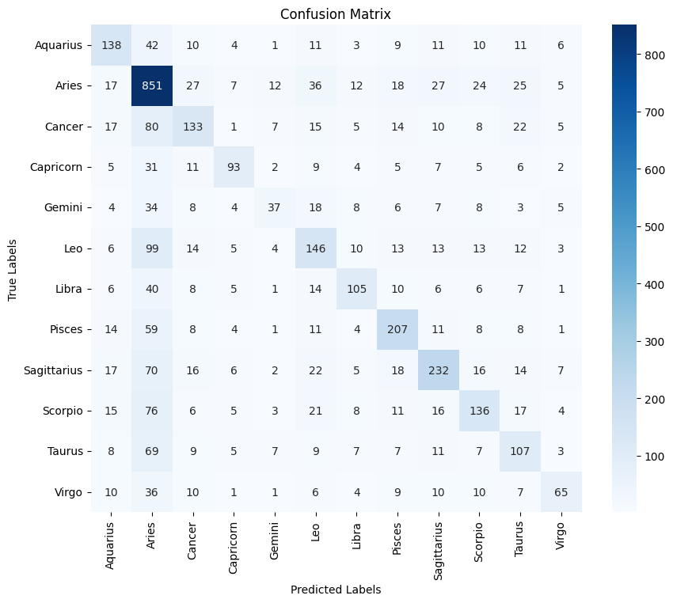
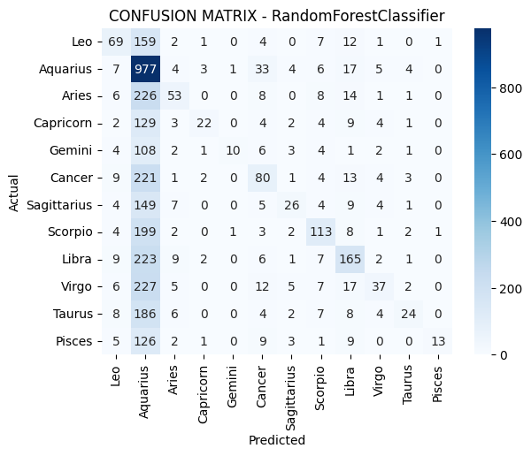
To measure performance of each model we used
Confusion Matrix
Notes:
A confusion matrix is often visualized using a heatmap. In a multi-class confusion matrix, the heatmap can have many boxes, especially if there are multiple classes. Each row in the heatmap corresponds to an actual class, and each column corresponds to a predicted class. The value in each box represents the count or percentage of instances that fall into that combination of true and predicted class.
It helps you understand the strengths and weaknesses of your classifier's performance on different classes.

Slide 17
Comparison and Insights
Both Random Forest Classifier and LinearSVC models showed strong predictive abilities for Zodiac Sign Prediction.
After hyperparameter tuning, LinearSVC achieved slightly higher accuracy, showcasing its effectiveness in this task.
Algorithm choice depends on factors like complexity, interpretability, and efficiency.
Random Forest excelled in capturing complex relationships, while LinearSVC leveraged text features.

Slide 18
Future Enhancements
Fine-tuning hyperparameters remains an avenue for improved results."
Feature engineering can enhance predictive power via techniques like embeddings.
Model ensemble, combining Random Forest and LinearSVC, could boost accuracy.
Incorporating external data sources could provide richer context for predictions.
Advanced NLP techniques like sentiment analysis can further enrich text data.
Online deployment, multilingual support, and ethical considerations are key for growth.
Notes:
Our project not only predicts Zodiac signs but also epitomizes the potential of data analysis to enhance, validate, and modernize age-old practices. It showcases the power of data to illuminate new perspectives on timeless subjects.

Slide 19
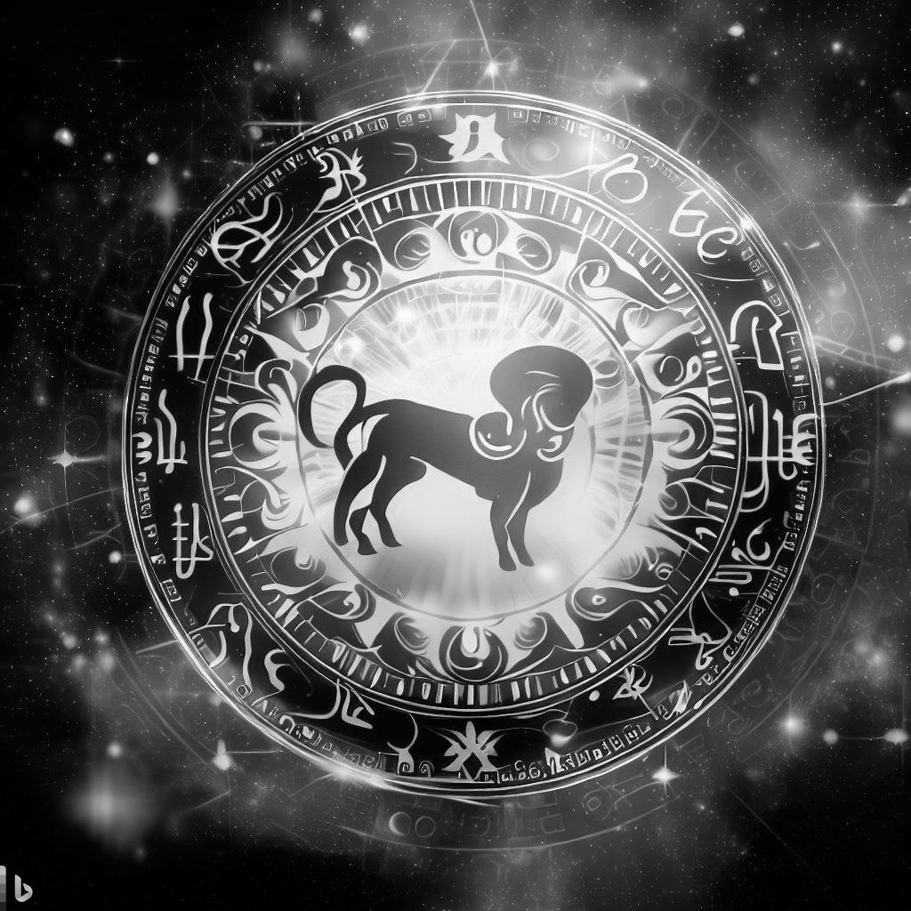
Thank You !

